Slide 1
Project 1
Header
#include <stdio.h>
#include <sys/types.h>
#include <sys/ipc.h>
#include <sys/shm.h>
#include <stdlib.h>
#include <unistd.h>
#include <errno.h>
/* key number */
#define SHMKEY ((key_t) 1497)

Slide 2
Key
Unix uses this key for identifying shared memory segments.
A key is a value of type key_t.
There are three ways to generate a key:
Do it yourself
Use function ftok()
Ask the system to provide a private key.

Slide 3
Key
Do it yourself:
#define SHMKEY ((key_t) 1497)
Use ftok() to generate one for you:
key_t = ftok(char *path, int ID);
path is a path name (e.g., “./”)
ID is an integer (e.g., ‘a’)
Function ftok() returns a key of type key_t: Key = ftok(“./”, ‘x’);
Keys are global entities. If other processes know your key, they can access your shared memory.
Ask the system to provide a private key using IPC_PRIVATE

Slide 4
Project 1
shared memory
typedef struct
{
int value;
} shared_mem;
shared_mem *total;
process1 increases the value of shared variable "total“ * by some number
process2
process3
process4

Slide 5
Project 1
Main function
int shmid, pid1,pid2, pid3,pid4, ID,status;
char *shmadd;
shmadd = (char *) 0;
/* Create and connect to a shared memory segment*/
if ((shmid = shmget (SHMKEY, sizeof(int), IPC_CREAT | 0666)) < 0)
{
perror ("shmget");
exit (1); }
if ((total = (shared_mem *) shmat (shmid, shmadd, 0)) == (shared_mem *) -1) {
perror ("shmat");
exit (0);
Use shmget() to request a shared memory:

Slide 6
Project 1
Initialize shared memory to 0
total->value = 0;
Create processes
if ((pid1 = fork()) == 0)
process1();
Create additional processes

Slide 7
Project 1
Parent wait for child processes to finish and print ID of each child. Three ways:
wait(&status)
wait(NULL)
waitpid(pid1, NULL, 0);
printf("Child %d pid has just exited.\n", pid1);

Slide 8
Project 1
To detach a shared memory, use shmdt(total);
total is the pointer returned by shmat()
if (shmdt(total) == -1) {
perror ("shmdt");
exit (-1);
}
To remove a shared memory, use shmctl(shmid, IPC_RMID, NULL);
shmid is the shared memory ID returned by shmget().
After a shared memory is removed, it no longer exists.

Slide 9
Notes
If you did not remove your shared memory segments (e.g., program crashes before the execution of shmctl()), they will be in the system forever. This will degrade the system performance.
Use the ipcs command to check if you have shared memory segments left in the system.
Use the ipcrm command to remove your shared memory segments.

Slide 10
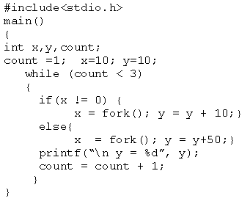
Example

